Slide 1
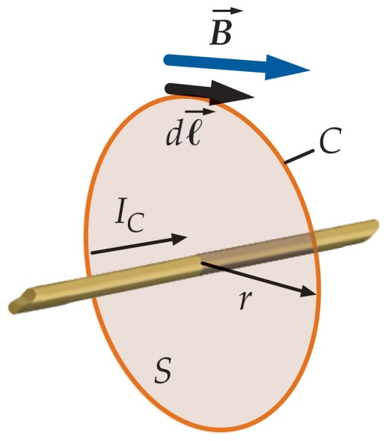
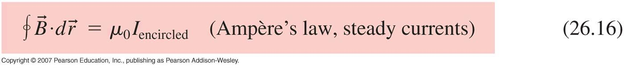
26.8 Ampère’s law
We found for highly symmetric charge distributions, we could calculate the electric field more easily using Gauss’s Law than Coulomb’s Law.
Similarly Ampère’s Law relates
the tangential component B_{t} of the magnetic field summed (integrated) around a closed curve C
to
the current I_{C} that passes through any surface bounded by C.
I_{encircled} is the net current that penetrates the surface bounded by the curve C.

Slide 2
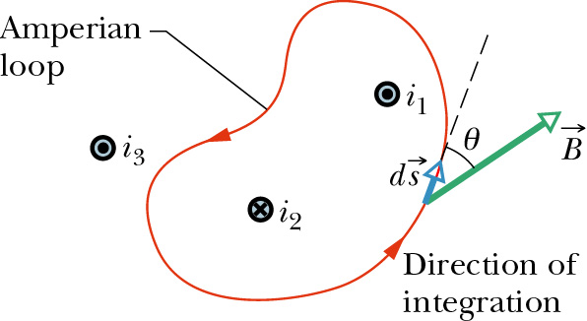
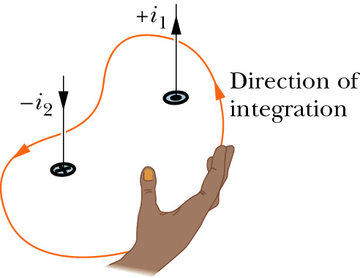
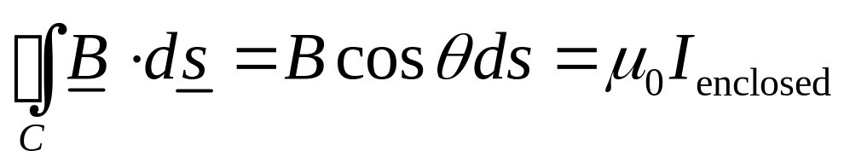
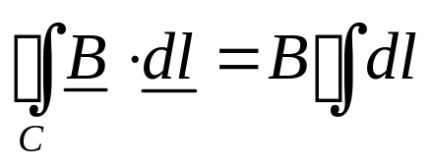
As in Gauss’s law, the field that appears in the integral is the net field arising from all sources, not just the encircled currents.
We can now use Ampère’s Law for situations where symmetry allows us to simplify, and solve the integral for the magnetic field.

Slide 3
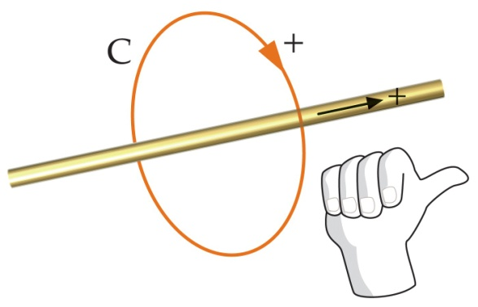
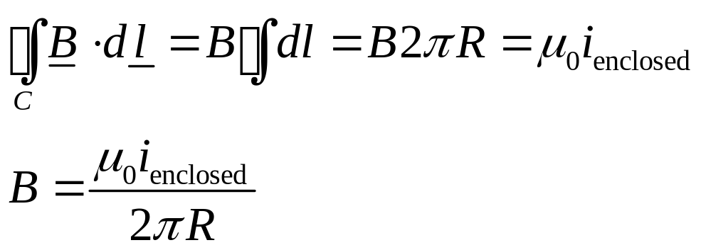
The simplest case is for an infinite long, straight, current-carrying wire.
Choose the circular curve centred on wire. Magnetic field is tangent to this circle from Biot-Savart law, and has the same magnitude all around the loop.

Slide 4
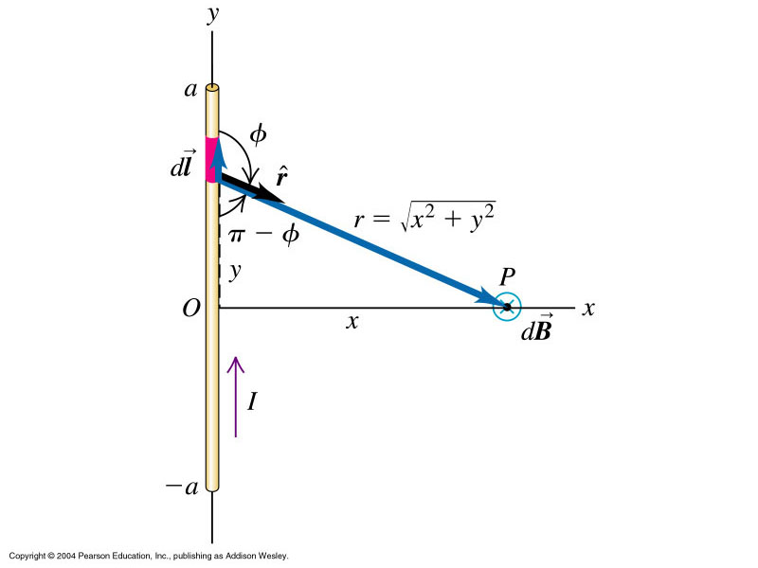
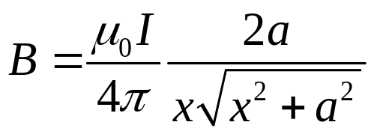

Compare with earlier result using Biot-Savart:
Magnetic field B due to a current in a straight wire.
If the length of the wire approaches infinity in both directions, we found

Slide 5
A.True
The magnetic field due to a current element is parallel to the current element.
The magnetic field due to a current element varies inversely with the square of the distance from the element.
The magnetic field due to a long wire varies inversely with the square of the distance from the wire.
Ampere’s law is valid only of there is a high degree of symmetry.
F. False
Magnetic fields
False
True
False
False

Slide 6
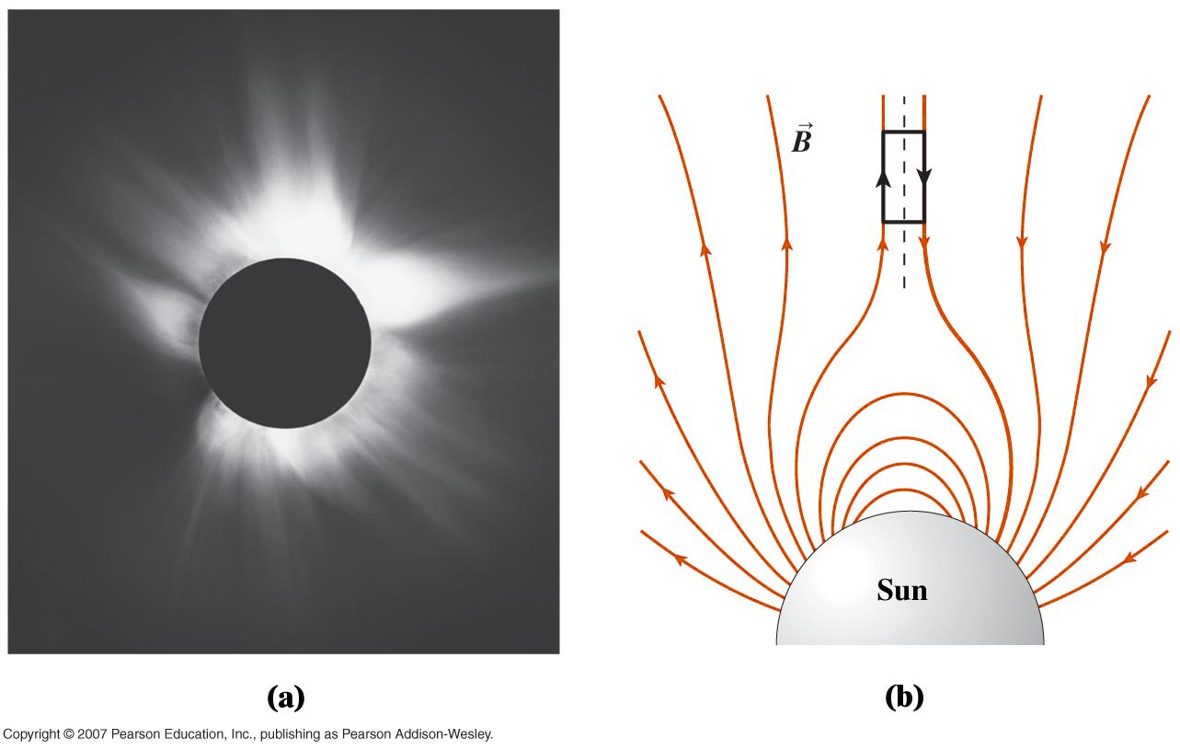
Example 26.7 Ampere’s law: solar currents

Slide 7
Applications of Ampere’s Law
Ex 26.8 Field outside and inside a long straight current- carrying wire
Ex 26.9 Field outside a current sheet
Ex 26.10 Field of a solenoid
Fig 26.39 Field of a toroidal solenoid

